Slide 1
Driving Maneuver Detection/Classification
Candidate Extraction & Model Based Learning
Transfer Learning with Multivariate Timeseries Dataset

Slide 2
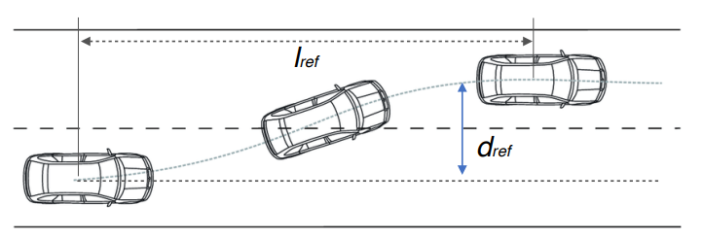
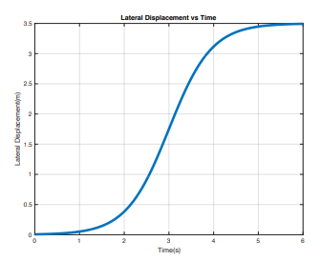
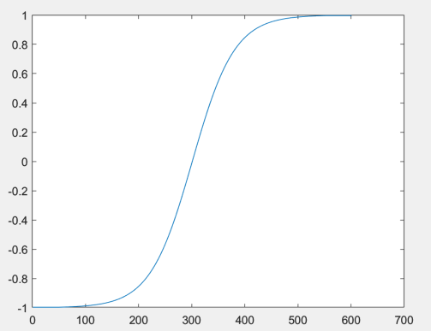
Pattern Based Detection
Candidate Extraction
Data Preparation
- Lateral offset feature generation
Find LC candidate
Tanh shape signal / Lateral Displacement
Evaluate LC candidate
Calculate DTW distance with AccelY/ SAS_Angle / GyroZ
Detect candidate by thresholding

Slide 3
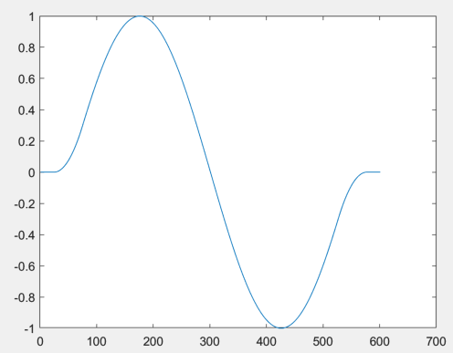
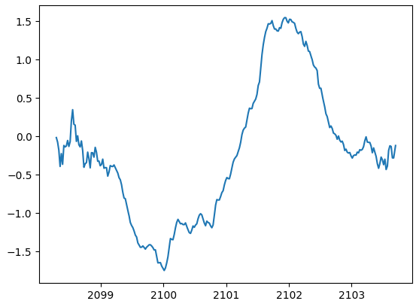
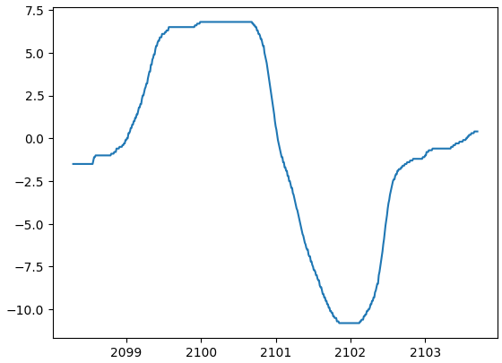
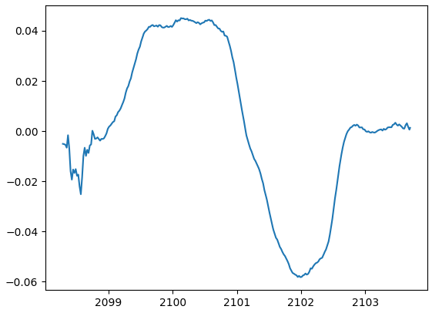
Pattern Based Detection
Candidate extraction
Data Preparation
- Lateral offset feature generation
Find LC candidate
Tanh shape signal / Lateral Displacement
Evaluate LC candidate
Calculate DTW distance with AccelY/ SAS_Angle / GyroZ
Detect candidate by thresholding
Signal
AccelY
SAS Angle
GyroZ

Slide 4
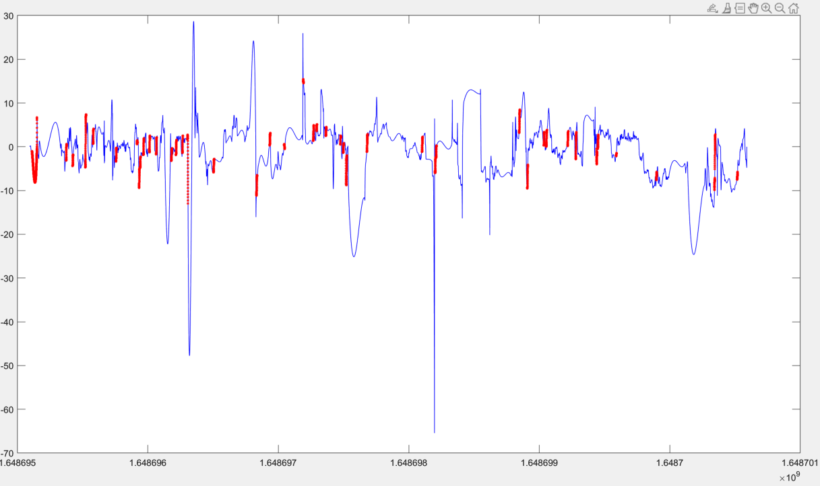
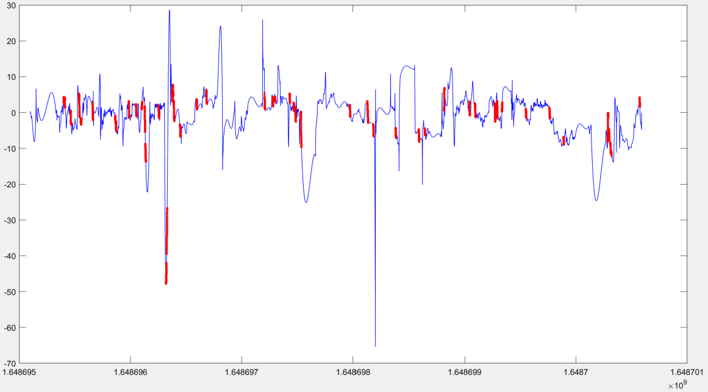
Pattern Based Detection
Hyperparameter setting
Left LC candidates(Lateral offset)
Data Preparation
- Data Sampling rate : 10Hz
Find LC candidate
Window_size = 25
Lc_thres = 3
LC_duration = 50
LC_pad_duration = 6
Evaluate LC candidate
Eval_duration = 50
Eval_pad_duration = 6
Eval_thres = 200
Right LC candidates(Lateral offset)

Slide 5
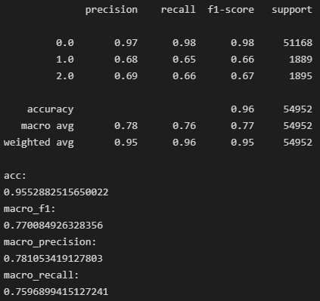
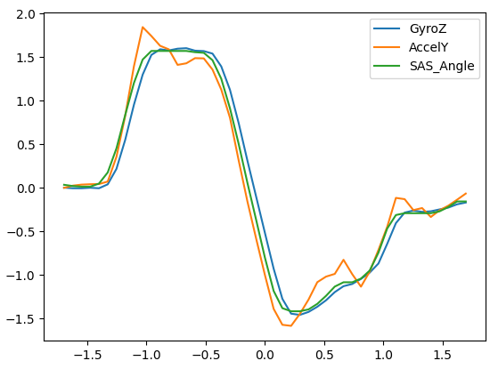
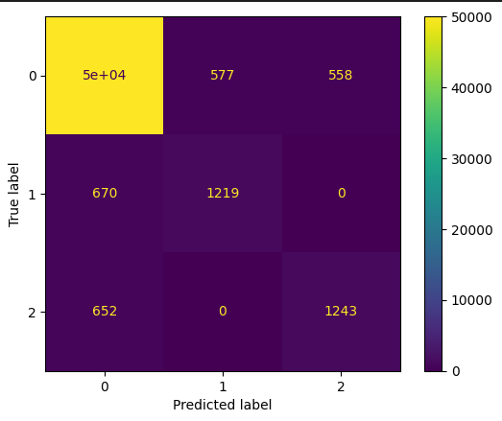
Pattern Based Detection
Hyperparameter setting
LC Candidate sample
2. Scoring for candidates
0 : not LC
1 : Left LC
2 : Right LC

Slide 6
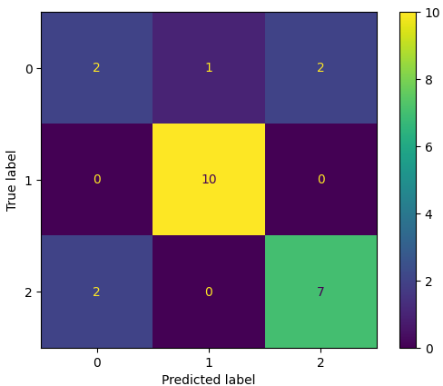
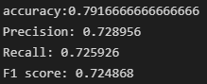
Deep Learing approach
Use lc candidate
Just using candidates for learning
(120, 60, 10) shape
120 samples , 60 length timeseries , 10 features
Timeseries padding with short timeseries length
Miss data which is not estimated as candidate
Additional model needed for each maneuver
Results with Simple Stacked-LSTM model

Slide 7
Deep Learing approach
Use lc candidate
Data sample
2. Using candidates information as feature
(5811, 32, 13) shape
5811 samples , 32 length timeseries , 13 features
Fixed sliding window (3.2sec) with overlapping 50%
3 features added (‘not candidate’(0), ‘LLC candidate’(1), ‘RLC candidate’(2))
Candidate features one-hot encoded
AccelX | AccelY | GyroZ
0.631470778 | 0.589931373 | 0.006331665
0.585083114 | 0.617225276 | 0.005952165
0.643681208 | 0.695994521 | 0.005452822
0.711377269 | 0.641885556 | 0.005765743
0.642723527 | 0.543962694 | 0.005865612
0.641107441 | 0.492068366 | 0.005113269
0.754472905 | 0.392828693 | 0.005932191
0.836294759 | 0.325970602 | 0.006551376
0.779791591 | 0.505954738 | 0.005239769
Not candidate | LLC candidate | RLC candidate
1 | 0 | 0
1 | 0 | 0
1 | 0 | 0
1 | 0 | 0
0 | 0 | 1
0 | 0 | 1
0 | 0 | 1
0 | 0 | 1
0 | 0 | 1
…
…

Slide 8
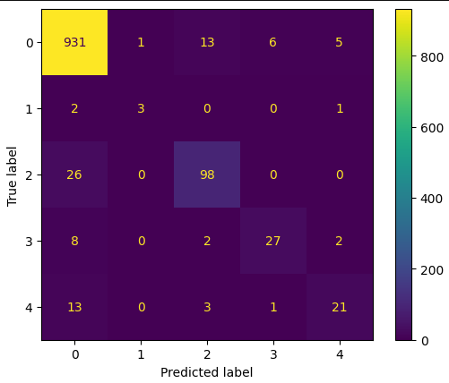
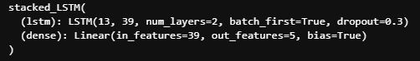
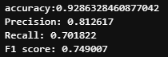
Deep Learing approach
HAR(Human-Activity-Recognition) model
HAR- Stacked LSTM
Label information
0: no_label 1: Acc 2: Dec 3: LLC 4 : RLC

Slide 9
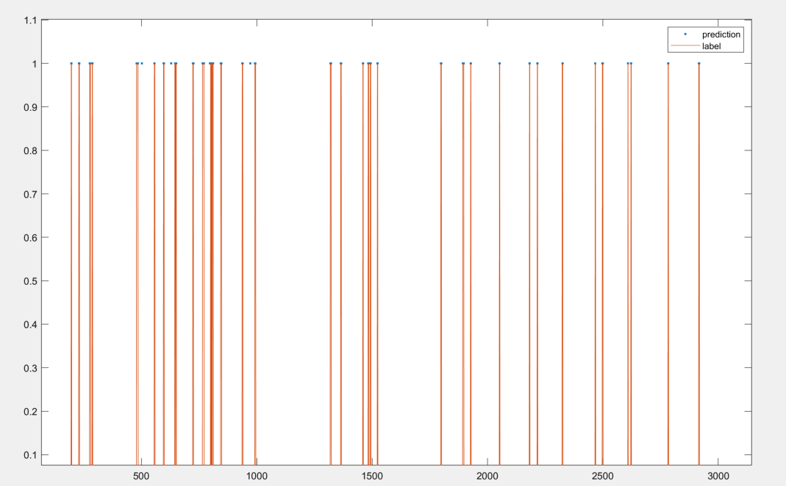
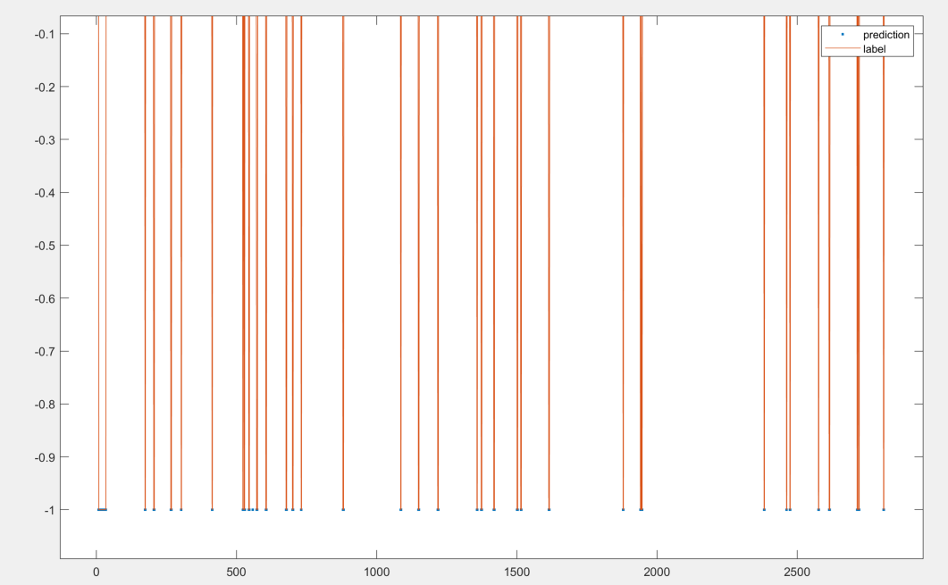
Deep Learing approach
HAR(Human-Activity-Recognition) model
HAR- Stacked LSTM Results plot
Label information
0: no_label -1 : Left LC 1: Right LC

Slide 10
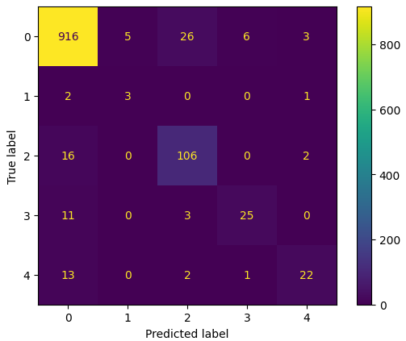
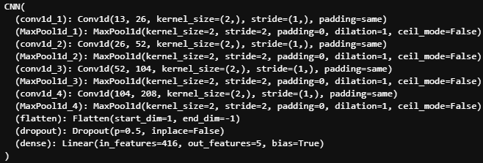
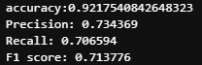
Deep Learing approach
HAR(Human-Activity-Recognition) model
HAR- CNN
Label information
0: no_label 1: Acc 2: Dec 3: LLC 4 : RLC

Slide 11

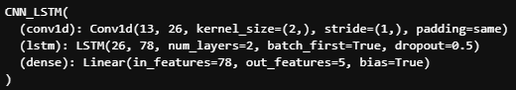
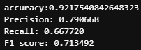
Deep Learing approach
HAR(Human-Activity-Recognition) model
HAR- CNN-LSTM
Label information
0: no_label 1: Acc 2: Dec 3: LLC 4 : RLC

Slide 12
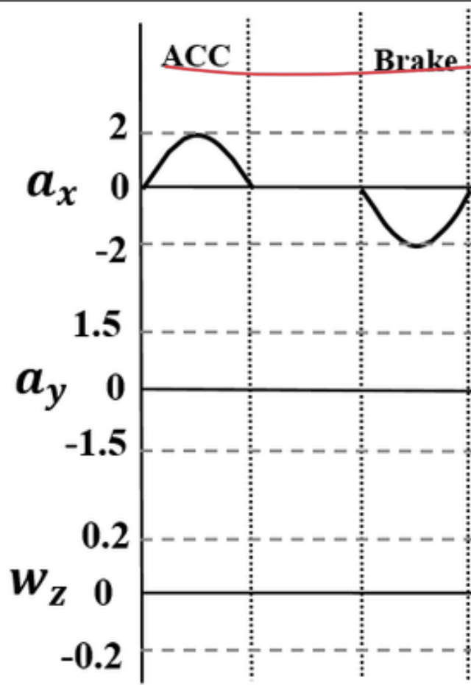
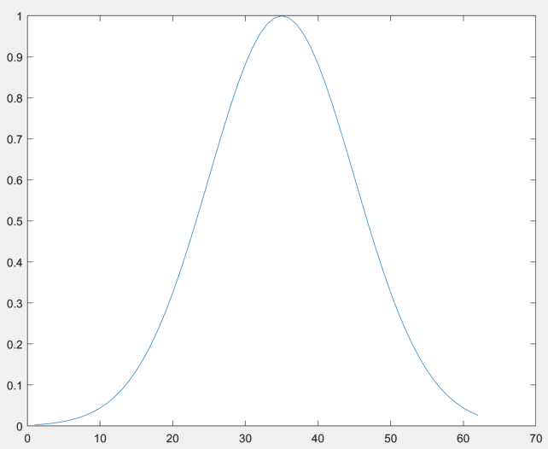
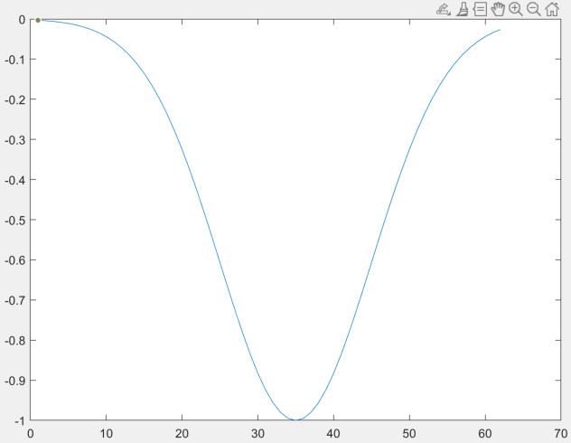
Pattern Based Detection
Candidate Extraction
Find ACC/Brake Candidate
Reference function (gaussian) with moderate length and amplitude
Compare with x-axis Acceleration
Thresholding DTW distance

Slide 13
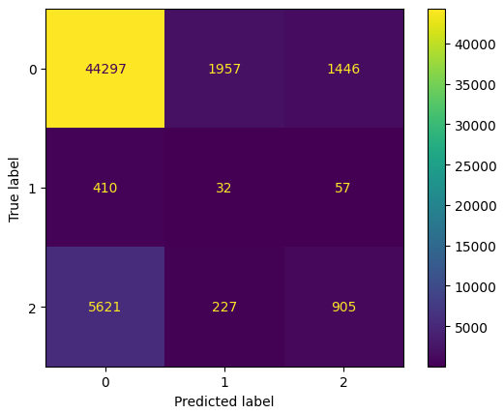
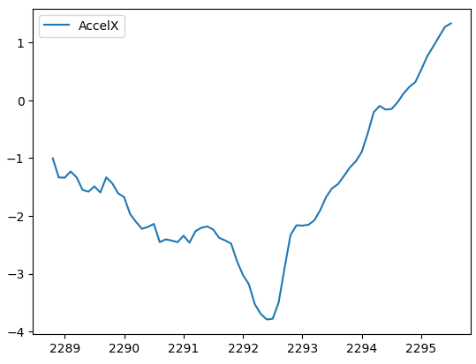
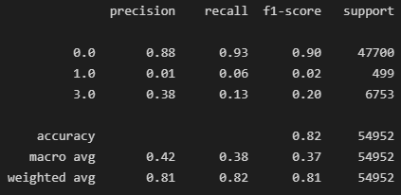
Pattern Based Detection
Candidate exxtraction
Dec Candidate sample
2. Scoring for candidates
0 : not LC
1 : Acc
2 : Dec

Slide 14

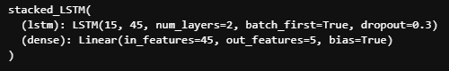
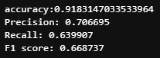
Deep Learing approach
Candidate extraction
Using candidates information as feature
(5811, 32, 15) shape
5811 samples , 32 length timeseries , 15 features
Fixed sliding window (3.2sec) with overlapping 50%
2 features added ( ‘Acc candidate’, ‘Dec candidate’)
Results with Simple Stacked-LSTM model

Slide 15
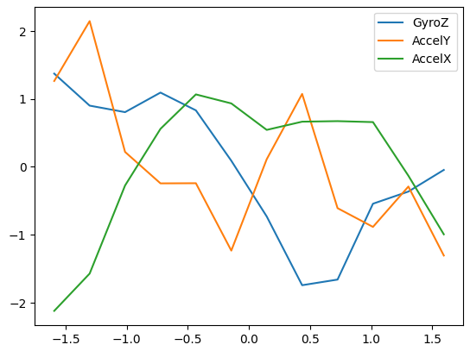
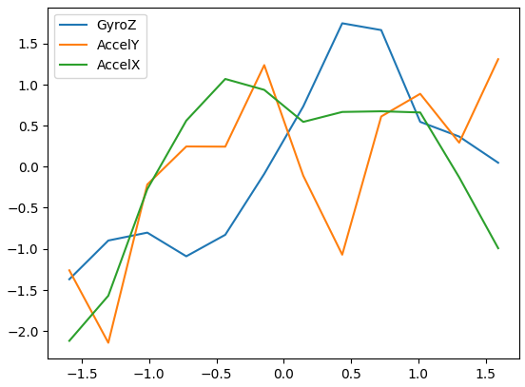
DATA Augmentation
Using Domain Specific knowledge
Acc
Augmentation by shifting y-axis features
Original Acc data sample
Y-axis shifted(augmented Data sample)

Slide 16
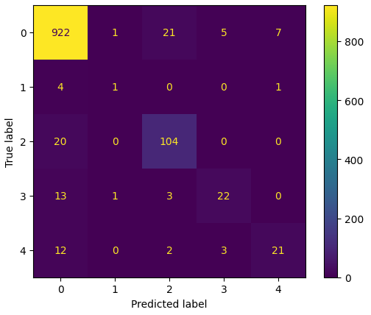
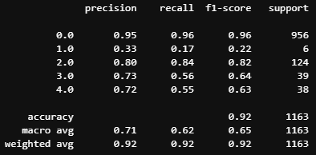
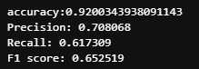
DATA Augmentation
Using Domain Specific knowledge
Acc
Augmentation by shifting y-axis features
Acc label prediction score decreased (overfitted to train data)

Slide 17

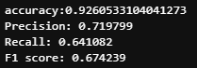
DATA Augmentation
data augmentation by adding noise
Acc
Adding gaussian noise with each columns’ (stdev/100)

Slide 18
Ensemble Learning
concept description
Ensemble Learning(앙상블 학습)
Generate various classifier and combine predictions
Develop scoring by mixing weak model rather than using one strong model
Many Engineer uses ensemble learning such as XGBoost, LightGBM algorithm on Machine learning open platform ‘Kaggle’
Detailed types of Ensemble Learning(앙상블 학습 유형)
Voting
Hard Voting, Soft Voting
Bagging
Categorical Data(다수결 투표 집계), Continuous Data(평균값 집계)
Boosting
Various classifier learn sequentially
Previous Classifier gives weights to next classifier to help predict wrong prediction in previous model
Dominate Ensemble learning (Best prediction score)

Slide 19

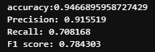
Ensemble Learning
for maneuver detection
Used Weak Classifiers
Voting with weights for each classifiers
KNN(K-Nearest-Neighborhood) w1
XGBoost w2
Stacked LSTM w3
CNN w4
CNN_LSTM w5
Optimal Weights
w1: 0.16
w2: 0.258
w3: 0.226
w4: 0.129
w5: 0.226
Results

Slide 20
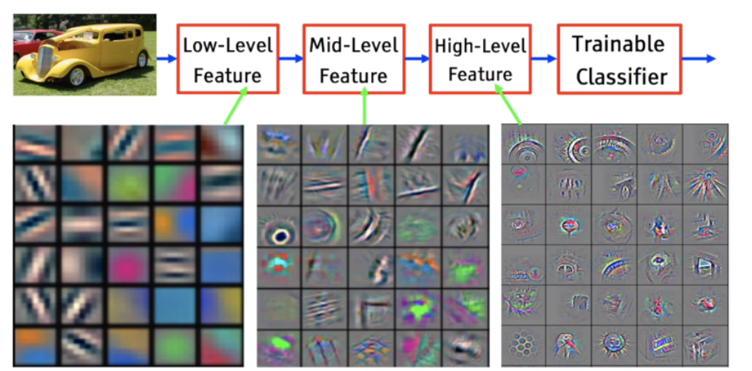
Transfer Learning(전이 학습)
using multivariate timeseries dataset
Transfer Learning(전이학습)
Method to use knowledge and information from one problem for other domain problem
For Deep Learning, generally use DNN(Deep Neural Network) made for some image classification task to adapt
for other dataset or task
Deep Learning Network learn various image’s general features (low-level , mid-level, high-level)

Slide 21
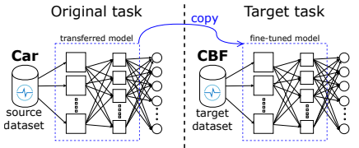
Transfer Learning(전이 학습)
using multivariate timeseries dataset
Transfer Learning for TimeSeriesClassification(TSC)
Transfer learning used when the target dataset does not contain enough labeled data[1]
It is successful for computer vision, but rarely applied to deep learning models for Timeseries data because of lack of
general purpose dataset [2,3]
Some TSC transfer learning research used ‘UCR archive dataset’[4]
Learning model for original source dataset and copy network except final classifier(dense) layer[4]
[1] J. Yosinski, J. Clune, Y. Bengio, and H. Lipson, “How transferable are features in deep neural networks?” in Advances in neural information processing systems, 2014, pp. 3320–3328.
[2] O. Russakovsky, J. Deng, H. Su, J. Krause, S. Satheesh, S. Ma, Z. Huang, A. Karpathy, A. Khosla, M. Bernstein, A. C. Berg, and L. Fei-Fei, “ImageNet Large Scale Visual Recognition Challenge,” International Journal of Computer Vision, vol. 115, no. 3, pp. 211–252, 2015.
[3] I. Krasin, T. Duerig, N. Alldrin, V. Ferrari, S. Abu-El-Haija, A. Kuznetsova, H. Rom, J. Uijlings, S. Popov, S. Kamali, M. Malloci, J. Pont-Tuset, A. Veit, S. Belongie, V. Gomes, A. Gupta, C. Sun, G. Chechik, D. Cai, Z. Feng, D. Narayanan, and K. Murphy, “OpenImages: A public dataset for large-scale multilabel and multi-class image classification.” Dataset available from https://storage.googleapis.com/openimages/web/index.html, 2017.
[4] Fawaz, H. I., Forestier, G., Weber, J., Idoumghar, L., & Muller, P. A. (2018, December). Transfer learning for time series classification. In 2018 IEEE international conference on big data (Big Data) (pp. 1367-1376). IEEE.

Slide 22
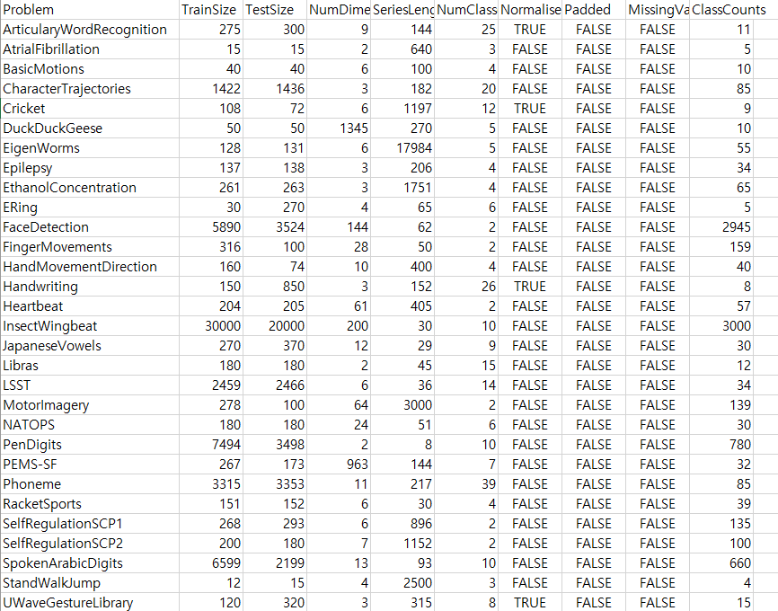
Transfer Learning(전이 학습)
using multivariate timeseries dataset
Dataset Description
Previous research was for univariate Timeseries Classification (UCR univariate TSC dataset)
Utilize UER multivariate TSC dataset for pretraining. (which is same data structure as out target task)[1]
[1] https://www.timeseriesclassification.com/dataset.php

Slide 23
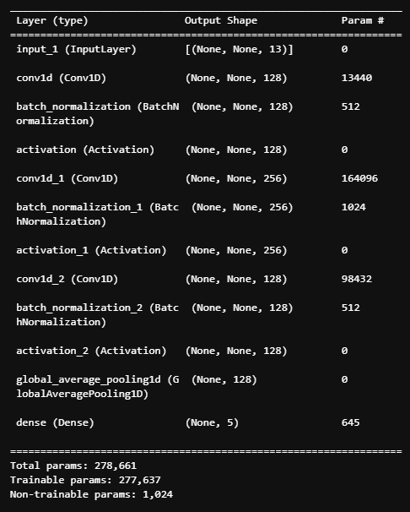
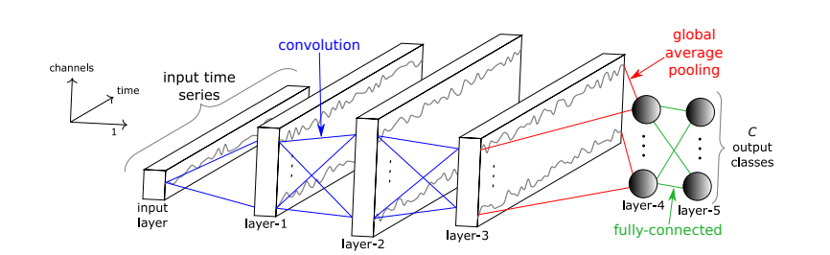
Transfer Learning(전이 학습)
using multivariate timeseries dataset
Used Model architecture and Hyperparameter
Model architectire and Hyperparameter from previous Research with TSC Problem[1]
One-dimensional Fully Convolutioinal Neural Network(FCN)
Global Average Pooling Layer reduce drastically the number of parameters
- Don’t need to rescale the input timeseries when transfer learning between time series with different length
Detail Architecture and Hyperparameters are shown below
Epochs : 2000
Batch_size : 16
Optimizer : Adam
Learning Rate : 0.001
First moment : 0.9
Second moment : 0.999
Loss function : Cross-entropy
[1] Z. Wang, W. Yan, and T. Oates, “Time series classification from scratch with deep neural networks: A strong baseline,” in International Joint Conference on Neural Networks, 2017, pp. 1578–1585

Slide 24
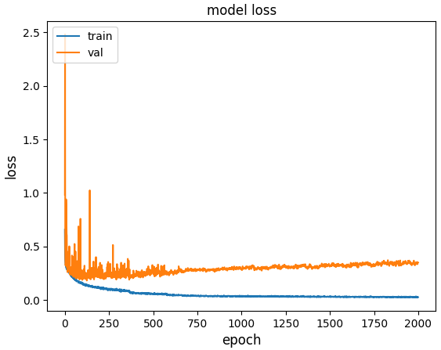
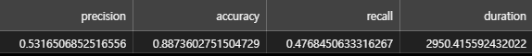
Transfer Learning(전이 학습)
using multivariate timeseries dataset
Output of suggested model architecture and hyperparameter(Target task alone)

Slide 25
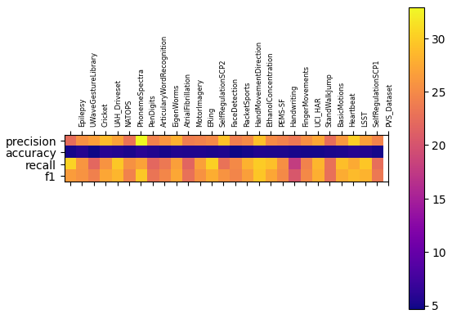
Transfer Learning(전이 학습)
using multivariate timeseries dataset
Heatmap with difference between original model & transfer learning model (%)

Slide 26
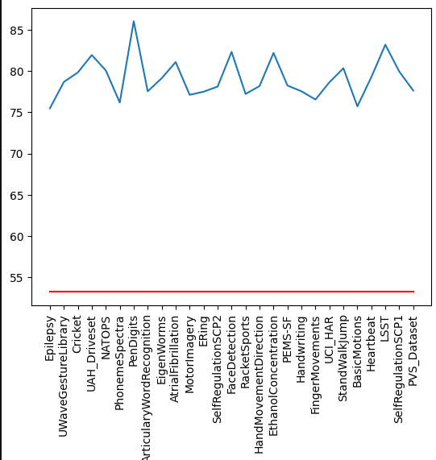
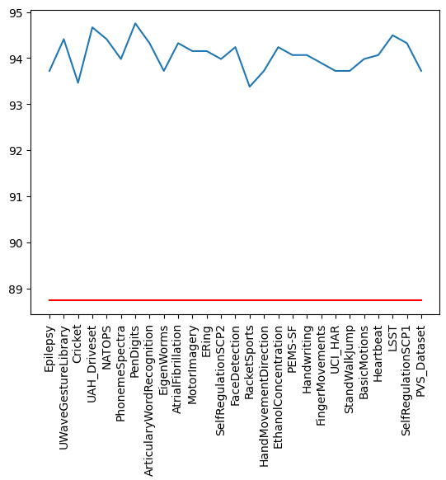
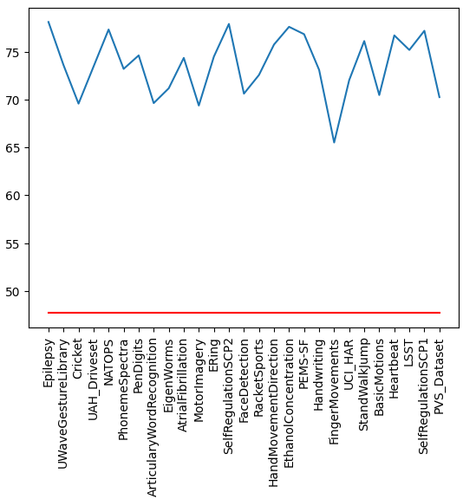

Transfer Learning(전이 학습)
using multivariate timeseries dataset
Fine-tuned model output
Precision(%)
Accuracy(%)
Recall(%)
F1(%)
With transfer
With transfer
With transfer
With transfer
Without transfer
Without transfer
Without transfer
Without transfer

Slide 27

Transfer Learning(전이 학습)
using multivariate timeseries dataset
Inter-Datasets similarity measures
Dataset Distance
Previous research shown that Inter-Datasets Similarity effects to transfer learning results[1]
We had N x 1 datasets similarity matrix since we have only one target task
Dependent DTW distance was used (multivariate timeseries) since original dataset was univariate timeseries
For the previous univariate ts dataset, high inter-dataset similarity leads to more improvement in accuracy
[1] Fawaz, Hassan Ismail, et al. "Transfer learning for time series classification." 2018 IEEE international conference on big data (Big Data). IEEE, 2018.

Slide 28




Transfer Learning(전이 학습)
using multivariate timeseries dataset
Fine-tuned model output (sorted by inter-dataset similarity)
No significant trend found
Precision(%)
Accuracy(%)
Recall(%)
F1(%)
With transfer
With transfer
With transfer
With transfer
Without transfer
Without transfer
Without transfer
Without transfer

Slide 29



Transfer Learning(전이 학습)
using multivariate timeseries dataset
Compare shape of timeseries
Target Dataset
‘PenDigits’ Dataset improved F1-score most
It has smooth shape and similar shape
‘StandWalkJump’ Dataset less improved F1-score
It has spiky shape different from target dataset
Shape similarity between ts dataset works for transfer learning
StandWalkJump
PenDigits

Slide 30



Transfer Learning(전이 학습)
using multivariate timeseries dataset
Best Precision, Accuracy,F1 improvement
‘PenDigits’ Dataset

Slide 31



Transfer Learning(전이 학습)
using multivariate timeseries dataset
Best Recall improvement
‘Epilepsy’ Dataset

Slide 32
Transfer Learning(전이 학습)
using multivariate timeseries dataset
Replace global averaging pooling layer to LSTM cell
LSTM cell
Epochs : 2000
Batch_size : 16
Optimizer : Adam
Learning Rate : 0.001
First moment : 0.9
Second moment : 0.999
Loss function : Cross-entropy
LSTM cell can represent time dependency over particular timeseries

Slide 33


Transfer Learning(전이 학습)
using multivariate timeseries dataset
Output of developed model architecture and hyperparameter(Target task alone)

Slide 34

Transfer Learning(전이 학습)
using multivariate timeseries dataset
Heatmap with difference between original model & transfer learning model (%)

Slide 35




Transfer Learning(전이 학습)
using multivariate timeseries dataset
Fine-tuned model output
Precision(%)
Accuracy(%)
Recall(%)
F1(%)
With transfer
With transfer
With transfer
With transfer
Without transfer
Without transfer
Without transfer
Without transfer

Slide 36




Transfer Learning(전이 학습)
using multivariate timeseries dataset
Fine-tuned model output (sorted by inter-dataset similarity)
No significant trend found
Precision(%)
Accuracy(%)
Recall(%)
F1(%)
With transfer
With transfer
With transfer
With transfer
Without transfer
Without transfer
Without transfer
Without transfer

Slide 37



Transfer Learning(전이 학습)
using multivariate timeseries dataset
Best Precision improvement
‘MotorImagery’ Dataset

Slide 38



Transfer Learning(전이 학습)
using multivariate timeseries dataset
Best Accuracy improvement
‘UWaveGestureLibrary’ Dataset

Slide 39



Transfer Learning(전이 학습)
using multivariate timeseries dataset
Best Recall, F1 improvement
‘Heartbeat’ Dataset

